Slide 1
MS SQL SERVER
SQL stands for Structured Query Language, as it is the special purpose domain-specific language for querying data in Relational Database Management System (RDBMS).
Microsoft SQL Server, MySQL, Oracle, etc. use SQL for querying with slight syntax differences.

Slide 2
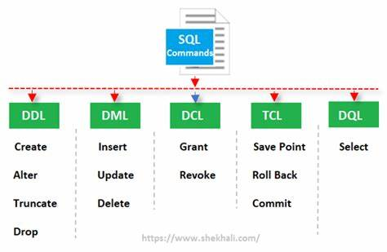
Types of SQL Statements
SQL statements are categorized into the types of statements,
which are
DML (DATA MANIPULATION LANGUAGE)
DDL (DATA DEFINITION LANGUAGE)
DCL (DATA CONTROL LANGUAGE)
TCL (TRANSACTION CONTROL LANGUAGE)
DQL (DATA QUERY LANGUAGE)

Slide 3
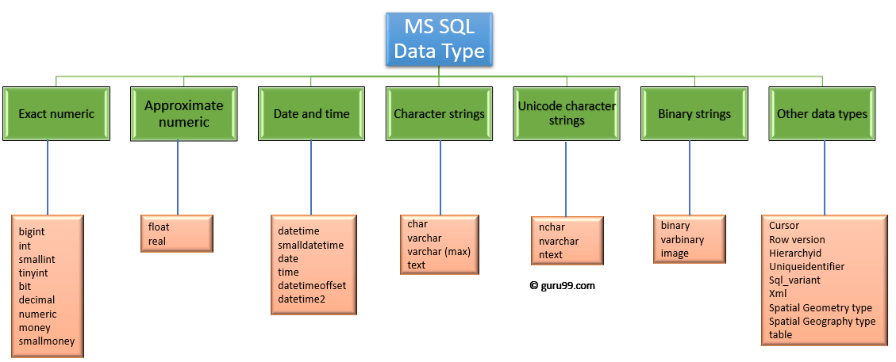

Slide 4
create table types
(
bigint_col bigint,
int_col INT,
smallint_col SMALLINT,
tinyint_col tinyint,
dec_col DECIMAL (4, 2),
num_col NUMERIC (4, 2),
bit_col BIT,
val CHAR(3),
val1 NCHAR(1) NOT NULL,
val2 VARCHAR(10) NOT NULL,
val3 NVARCHAR(20) NOT NULL,
created_at DATETIME2,
dob DATE NOT NULL,
login TIME (0) NOT NULL,
modified_on DATETIMEOFFSET NOT NULL
)
insert into types values
(
9223372036854775807,
2147483647,
32767,
255,
10.05,
20.05,
1,
'a',
N'あ',
'Hello',
(N'ありがとうございました'),
getdate(),
'2000-01-31',
'11:30:30',
'2019-02-28 01:45:00.0000000 -08:00'
)

Slide 5
CHAR –
To store fixed-length character string data in the database, length ranges from 1 to 8,000.
The storage size of a CHAR value is n bytes. (Size is 1 bytes for a character)
NCHAR – National Character
To store fixed-length, Unicode character string data in the database, length ranges from 1 to 4,000 – (For UTF-16 encoding)
The storage size of a NCHAR value is two times n bytes. (Size is 2 bytes for a character)
NVARCHAR [ ( n | max ) ]
Variable-size string data. n defines the string size in byte-pairs, and can be a value from 1 through 4,000. max indicates that the maximum storage size is 2^31-1 characters (2 GB). The storage size is two times n bytes + 2 bytes. For UCS-2 encoding, the storage size is two times n bytes + 2 bytes and the number of characters that can be stored is also n. For UTF-16 encoding, the storage size is still two times n bytes + 2 bytes
CREATE TABLE sql_server_nchar ( NCharVal NCHAR(1) NOT NULL );
The following insert statement inserts the character a (あ) in Japanese into the NCHAR column:
INSERT INTO test.sql_server_nchar (val) VALUES (N'あ');

Slide 6
VARCHAR vs. NVARCHAR
VARCHAR NVARCHAR
Character Data Type Variable-length, non-Unicode characters Variable-length, both Unicode and non-Unicode characters such as Japanese, Korean, and Chinese.
Maximum Length Up to 8,000 characters Up to 4,000 characters
Character Size Takes up 1 byte per character Takes up 2 bytes per Unicode/Non-Unicode character
Storage Size Actual Length (in bytes) 2 times Actual Length (in bytes)
Usage Used when data length is variable or variable length columns and if actual data is always way less than capacity Due to storage only, used only if you need Unicode support such as the Japanese Kanji or Korean Hangul characters.

Slide 7
DROP, DELETE and TRUNCATE commands
 | DELETE Command | DROP Command | TRUNCATE Command
Language | The DELETE command is Data Manipulation Language Command. | The DROP command is Data Definition Language Command. | The TRUNCATE command is a Data Definition Language Command.
Use | The DELETE command deletes one or more existing records from the table in the database. | The DROP Command drops the complete table from the database. | The TRUNCATE Command deletes all the rows from the existing table, leaving the row with the column names.
Transition | We can restore any deleted row or multiple rows from the database using the ROLLBACK command. | We cannot get the complete table deleted from the database using the ROLLBACK command. | We cannot restore all the deleted rows from the database using the ROLLBACK command.
Memory Space | The DELETE command does not free the allocated space of the table from memory. | The DROP command removes the space allocated for the table from memory. | The TRUNCATE command does not free the space allocated for the table from memory.
Performance Speed | The DELETE command performs slower than the DROP command and TRUNCATE command as it deletes one or more rows based on a specific condition. | The DROP Command has faster performance than DELETE Command but not as compared to the Truncate Command because the DROP command deletes the table from the database after deleting the rows. | The TRUNCATE command works faster than the DROP command and DELETE command because it deletes all the records from the table without any condition.
Integrity Constraints | The Integrity Constraints remain the same in the DELETE command. | The Integrity Constraints get removed for the DROP command. | The Integrity Constraints will not get removed from the TRUNCATE command.
Permission | DELETE permission is required to delete the rows of the table. | We need ALTER permission on the schema to which the table belongs and CONTROL permission on the table to use the DROP command. | We need table ALTER permission to use the TRUNCATE command.
Syntax | DELETE FROM table_name WHERE condition; | DROP TABLE table_name; | TRUNCATE TABLE table_name;

Slide 8
| SQL Server MySQL Postgres DB2
---------------------------------------------------
tinyint | X X
smallint | X X X X
mediumint | X
int/integer | X X X X
bigint | X X X X
And they support the same value ranges (with one exception below) and all have the same storage requirements:
| Bytes Range (signed) Range (unsigned)
--------------------------------------------------------------------------------------------
tinyint | 1 byte -128 to 127 0 to 255
smallint | 2 bytes -32768 to 32767 0 to 65535
mediumint | 3 bytes -8388608 to 8388607 0 to 16777215
int/integer | 4 bytes -2147483648 to 2147483647 0 to 4294967295
bigint | 8 bytes -9223372036854775808 to 9223372036854775807 0 to 18446744073709551615
The "unsigned" types are only available in MySQL, and the rest just use the signed ranges, with one notable exception: tinyint in SQL Server is unsigned and has a value range of 0 to 255

Slide 9
Property | DateTime | DateTime2
Syntax | DateTime | DateTime2[ ( n )] where n is fractional seconds precision from 0 to 7
Format | YYYY-MM-DD hh:mm:ss.nnn | YYYY-MM-DD hh:mm:ss[.n]
Date range | January 1, 1753, through December 31, 9999 | through 9999-12-31
Time range | 00:00:00 through 23:59:59.997 | 00:00:00 through 23:59:59.9999999
Usage | DECLARE @MyDatetime datetime | DECLARE @MyDatetime2 datetime2(7)
Fractional seconds range | Zero to three digits, ranging from 0 to 999 represents the fractional seconds. | Zero- to seven-digit number from 0 to 9999999 represents the fractional seconds
Accuracy | Rounded to increments of .000, .003, or .007 seconds | 100 nanoseconds
Default value | 1900-01-01 00:00:00 | 1900-01-01 00:00:00
Character length | 19 positions minimum to 23 maximum | 19 positions minimum to 27 maximum
User-defined fractional second precision | No | Yes
Storage size | 8 bytes | 6 bytes for precision less than 3.
ANSI and ISO 8601 compliance | No | Yes

Slide 10
Introduction to SQL Server GUID
All things in our world are numbered e.g., books have ISBNs, cars have VINs, and people have social security numbers (SSN).
The numbers, or identifiers, help us reference things unambiguously. For example, we can identify John Doe by using his unique social security number 123-45-6789.
A globally unique identifier or GUID is a broader version of this type of ID numbers.
A GUID is guaranteed to be unique across tables, databases, and even servers.
In SQL Server, GUID is 16-byte binary data type, which is generated by using the NEWID() function:select NEWID() from GUID
DECLARE
@id UNIQUEIDENTIFIER;
SET @id = NEWID();
SELECT
@id AS GUID;
Create table demo
(
customer_id UNIQUEIDENTIFIER DEFAULT NEWID()
)

Slide 11
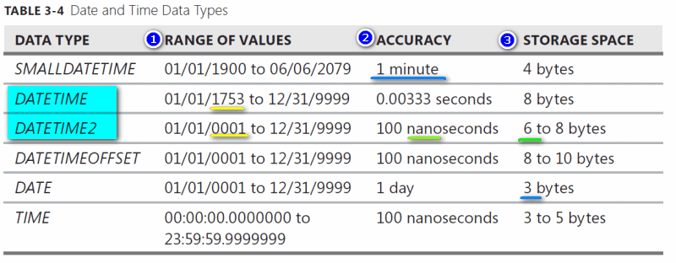

Slide 12
Sorting data
ORDER BY – sort the result set based on values in a specified list of columns
SELECT
select_list
FROM
table_name
ORDER BY
column_name | expression [ASC | DESC ];
SELECT
first_name,
last_name
FROM
sales.customers
ORDER BY
first_name;

Slide 13
Limiting rows
OFFSET FETCH – limit the number of rows returned by a query.
SELECT TOP – limit the number of rows or percentage of rows returned in a query’s result set.
ORDER BY column_list [ASC |DESC]
OFFSET offset_row_count {ROW | ROWS}
FETCH {FIRST | NEXT} fetch_row_count {ROW | ROWS} ONLY
In this syntax:
The OFFSET clause specifies the number of rows to skip before starting to return rows from the query. The offset_row_count can be a constant, variable, or parameter that is greater or equal to zero.
The FETCH clause specifies the number of rows to return after the OFFSET clause has been processed. The offset_row_count can a constant, variable or scalar that is greater or equal to one.
The OFFSET clause is mandatory while the FETCH clause is optional. Also, the FIRST and NEXT are synonyms respectively so you can use them interchangeably. Similarly, you can use the FIRST and NEXT interchangeably.

Slide 14
SELECT
product_name,
list_price
FROM
production.products
ORDER BY
list_price,
product_name
OFFSET 10 ROWS;
SELECT
product_name,
list_price
FROM
production.products
ORDER BY
list_price,
product_name
OFFSET 10 ROWS
FETCH NEXT 10 ROWS ONLY;
SELECT
product_name,
list_price
FROM
production.products
ORDER BY
list_price DESC,
product_name
OFFSET 0 ROWS
FETCH FIRST 10 ROWS ONLY;

Slide 15
SELECT TOP 10
product_name,
list_price
FROM
production.products
ORDER BY
list_price DESC;
SELECT TOP 3 WITH TIES
product_name,
list_price
FROM
production.products
ORDER BY
list_price DESC;
SELECT TOP (expression) [PERCENT]
[WITH TIES]
FROM
table_name
ORDER BY
column_name;
SELECT TOP 1 PERCENT
product_name,
list_price
FROM
production.products
ORDER BY
list_price DESC;

Slide 16
Filtering data
DISTINCT – select distinct values in one or more columns of a table.
WHERE – filter rows in the output of a query based on one or more conditions.
AND – combine two Boolean expressions and return true if all expressions are true.
OR– combine two Boolean expressions and return true if either of conditions is true.
IN – check whether a value matches any value in a list or a subquery.
BETWEEN – test if a value is between a range of values.
LIKE – check if a character string matches a specified pattern.
Column & table aliases(joins) – show you how to use column aliases to change the heading of the query output and table alias to improve the readability of a query.
select * from emp where empname='john' COLLATE SQL_Latin1_General_CP1_CS_AS;
-- retrieve case sensitive record

Slide 17
Data definition
CREATE DATABASE – show you how to create a new database in a SQL Server instance using the CREATE DATABASE statement and SQL Server Management Studio.
DROP DATABASE – learn how to delete existing databases.
CREATE SCHEMA – describe how to create a new schema in a database.
ALTER SCHEMA – show how to transfer a securable from a schema to another within the same database.
DROP SCHEMA – learn how to delete a schema from a database.
CREATE TABLE – walk you through the steps of creating a new table in a specific schema of a database.
Identity column – learn how to use the IDENTITY property to create the identity column for a table.
Sequence – describe how to generate a sequence of numeric values based on a specification.
ALTER TABLE ADD column – show you how to add one or more columns to an existing table
ALTER TABLE ALTER COLUMN – show you how to change the definition of existing columns in a table.
ALTER TABLE DROP COLUMN – learn how to drop one or more columns from a table.
Computed columns – how to use the computed columns to resue the calculation logic in multiple queries.
DROP TABLE – show you how to delete tables from the database.
TRUNCATE TABLE – delete all data from a table faster and more efficiently.
SELECT INTO – learn how to create a table and insert data from a query into it.
Rename a table – walk you through the process of renaming a table to a new one.
Temporary tables – introduce you to the temporary tables for storing temporarily immediate data in stored procedures or database session.
Synonym – explain you the synonym and show you how to create synonyms for database objects.

Slide 18
CREATE DATABASE database_name;
DROP DATABASE IF EXISTS TestDb;
ALTER DATABASE [Test] MODIFY NAME = [Test2]
EXEC sp_renamedb 'Test', 'Test2'
INSERT INTO
sales.addresses (street, city, state, zip_code)
SELECT
street,
city,
state,
zip_code
FROM
sales.stores
WHERE
city IN ('Santa Cruz', 'Baldwin')
INSERT TOP (10)
INTO
sales.addresses (street, city, state, zip_code)
SELECT
street,
city,
state,
zip_code
FROM
sales.customers
ORDER BY
first_name,
last_name;
CREATE SCHEMA schema_name
[AUTHORIZATION owner_name]
DROP SCHEMA [IF EXISTS] schema_name;
ALTER SCHEMA NEW_NAMED_SCHEMA
TRANSFER OLD_NAMED_SCHEMA.TABLE_NAME;
SELECT
select_list
INTO
destination
FROM
source
[WHERE condition]
SELECT
*
INTO
Marketing.customers
FROM
sales.customers;
EXEC sp_rename 'old_table_name', 'new_table_name'

Slide 19
ALTER STATEMENT
COMPUTED COLUMNS
ALTER TABLE sales.quotations
ADD
amount DECIMAL (10, 2) NOT NULL,
customer_name VARCHAR (50) NOT NULL;
ALTER TABLE table_name
ALTER COLUMN column_name new_data_type(size);
ALTER TABLE sales.price_lists
DROP COLUMN discount, surcharge;
ALTER TABLE persons
ADD full_name AS (first_name + ' ' + last_name);
(or)
(if deterministic - Note that a computed column is persisted only if its expression is deterministic. It means that for a set of inputs, the expression always returns the same result)
ALTER TABLE persons
ADD full_name AS (first_name + ' ' + last_name) PERSISTED;
SELECT
person_id,
full_name,
dob
FROM
persons
ORDER BY
full_name;
SELECT
person_id,
first_name + ' ' + last_name AS full_name,
dob
FROM
persons
ORDER BY
full_name;

Slide 20
Identity -auto-increment
Syntax: IDENTITY [(seed,increment)]
Seed: Starting value of a column. The default value is 1.Increment: It specifies the incremental value that is added to the identity column
value of the previous row.The default value is 1.*/
To explicitly supply a value for the identity column
First, turn on identity insert → SET Identity_Insert Table_name ON
Secondly, you need to specify the identity column name in the insert query as shown below:
Insert into Person(PersonId, Name) values(5, 'jancy');--correct format to insert in identity column
Reset the Identity Column Value in SQL Server
DBCC CHECKIDENT(Person, RESEED, 0); --Use DBCC command to reset the identity column value
Select SCOPE_IDENTITY()
Select @@IDENTITY
Select IDENT_CURRENT('table_name')
SCOPE_IDENTITY(): The SCOPE_IDENTITY() built-in function returns the last identity column value that is created within the same session and the same scope.
@@IDENTITY: The @@IDENTITY() built-in function returns the last identity column value that is created in the same session but with any scope.
IDENT_CURRENT(‘TableName’): The IDENT_CURRENT() built-in function returns the last identity column value that is created for a specific table across any session and any scope.

Slide 21
What is a synonym in SQL Server?
In SQL Server, a synonym is an alias or alternative name for a database object such as a table, view, stored procedure, user-defined function, and sequence.
A synonym provides you with many benefits if you use it properly.
Creating a synonym within the same database example
use TestDB;
select * from sales.orders;
CREATE SYNONYM orders FOR sales.orders;
select * from orders;
--Removing a synonym
DROP SYNONYM IF EXISTS orders;
Creating a synonym for a table in another database
CREATE DATABASE test;
USE test;
CREATE SCHEMA purchasing;
CREATE TABLE purchasing.suppliers
(
);
--switch to TestDB database
use TestDB
CREATE SYNONYM suppliers
FOR test.purchasing.suppliers;
SELECT * FROM suppliers;

Slide 22
EXAMPLE FOR NORMALIZATION
UNNORMALIZED FORM (UNF)
EMPLOYEE
ID | NAME | DESIGNATION | DEPTID | DEPTNAME | MOBILE | ADDRESS
1 | JOHN | DEVELOPER | 100 | DEVELOPMENT | 6325478962, 9865741236 | 234 Hinton Rd Mannford, Oklahoma(OK), 74044
2 | JAMIE | DESIGNER | 101 | UI/UX | 7893245698 | 214 Doorley Rd Sidney, Ohio(OH), 45365
3 | JACK | DEVELOPER | 100 | DEVELOPMENT | 9856741236, 5647896523 | 236 Hinton Rd Mannford, Oklahoma(OK), 74044

Slide 23
FIRST NORMAL FORM (1NF)
EMPLOYEE
ID | NAME | DESIGNATION | DEPTID | DEPTNAME | MOBILE | ADDRESS
1 | JOHN | DEVELOPER | 100 | DEVELOPMENT | 6325478962 | 234 Hinton Rd Mannford, Oklahoma(OK), 74044
1 | JOHN | DEVELOPER | 100 | DEVELOPMENT | 9865741236 | 234 Hinton Rd Mannford, Oklahoma(OK), 74044
2 | JAMIE | DESIGNER | 101 | UI/UX | 7893245698 | 214 Doorley Rd Sidney, Ohio(OH), 45365
3 | JACK | DEVELOPER | 100 | DEVELOPMENT | 9856741236 | 236 Hinton Rd Mannford, Oklahoma(OK), 74044
3 | JACK | DEVELOPER | 100 | DEVELOPMENT | 5647896523 | 236 Hinton Rd Mannford, Oklahoma(OK), 74044

Slide 24
SECOND NORMAL FORM (2NF)
EMPLOYEE
DEPARTMENT
ID(PK) | NAME | DESIGNATION | DEPTID(FK) | MOBILE1 | MOBILE2 | ADDRESS
1 | JOHN | DEVELOPER | 100 | 9865741236 | 6325478962 | 234 Hinton Rd Mannford, Oklahoma(OK), 74044
2 | JAMIE | DESIGNER | 101 | UI/UX | 7893245698 | 214 Doorley Rd Sidney, Ohio(OH), 45365
3 | JACK | DEVELOPER | 100 | 5647896523 | 9856741236 | 236 Hinton Rd Mannford, Oklahoma(OK), 74044
DEPTID(PK) | DEPTNAME
100 | DEVELOPER
101 | UI/UX

Slide 25
THIRD NORMAL FORM (3NF)
EMPLOYEE
DEPARTMENT
ID | NAME | DESIGNATION | DEPTID | MOBILE1 | MOBILE2 | STREET ADDRESS | ADDRESSID
1 | JOHN | DEVELOPER | 100 | 9865741236 | 6325478962 | 234 Hinton Rd | 1
2 | JAMIE | DESIGNER | 101 | 7893245698 | null | 214 Doorley Rd | 2
3 | JACK | DEVELOPER | 100 | 5647896523 | 9856741236 | 236 Hinton Rd | 1
DEPTID | DEPTNAME
100 | DEVELOPER
101 | UI/UX
ADDRESS
ADDRESSID | CITY | STATE | PINCODE
1 | Mannford | Oklahoma(OK) | 74044
2 | Sidney | Ohio(OH) | 45365

Slide 26
END OF SESSIONS 14.03.2023 TO 17.03.2023

